Slide 1
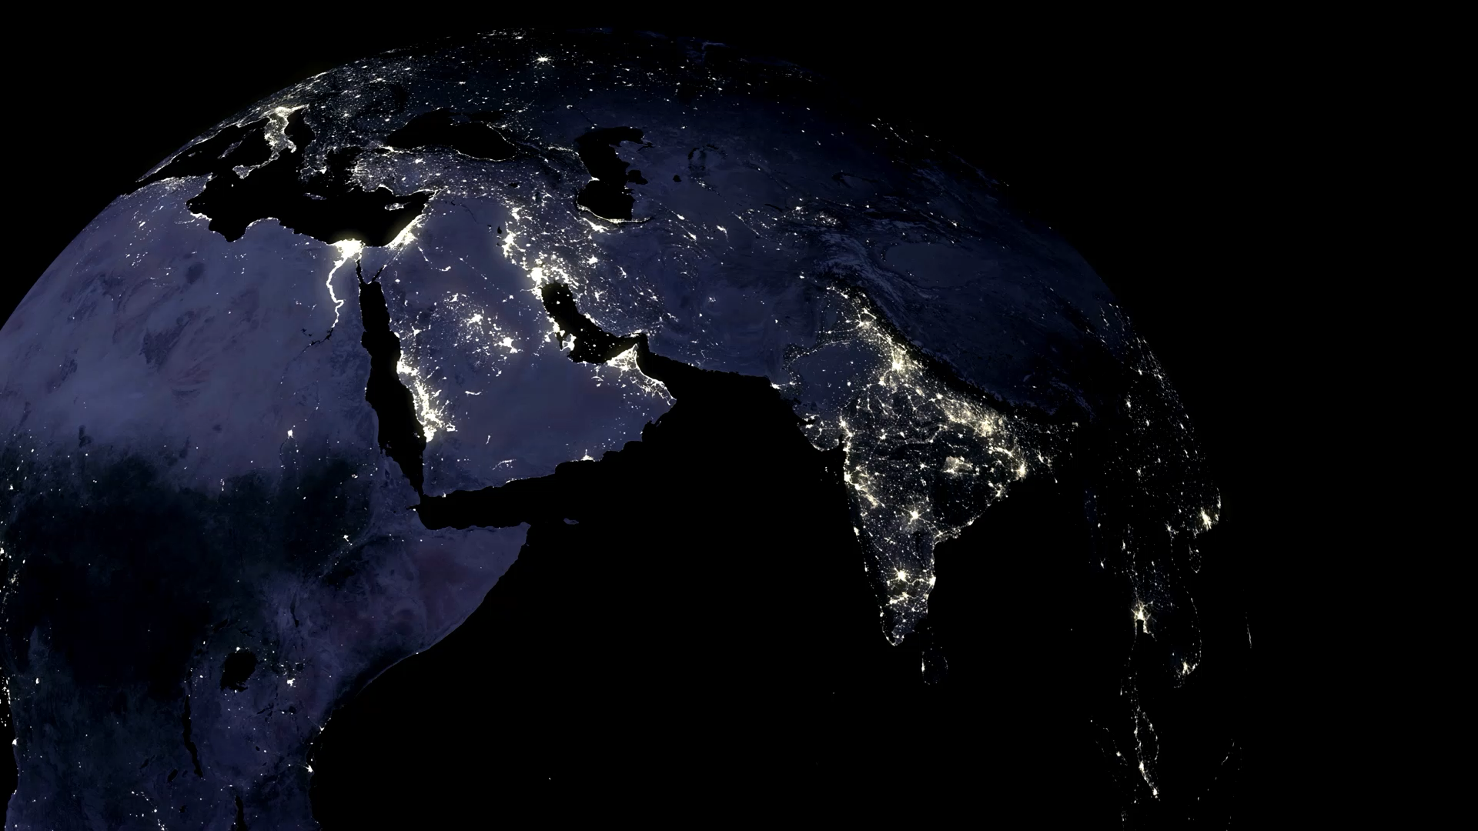

World-population2023
Swapnil More

Slide 2
Introduction
- According to the United Nations, the world population was estimated to be 7.9 billion in 2021, and it's projected to reach 9.7 billion by next 5 years.

Slide 3
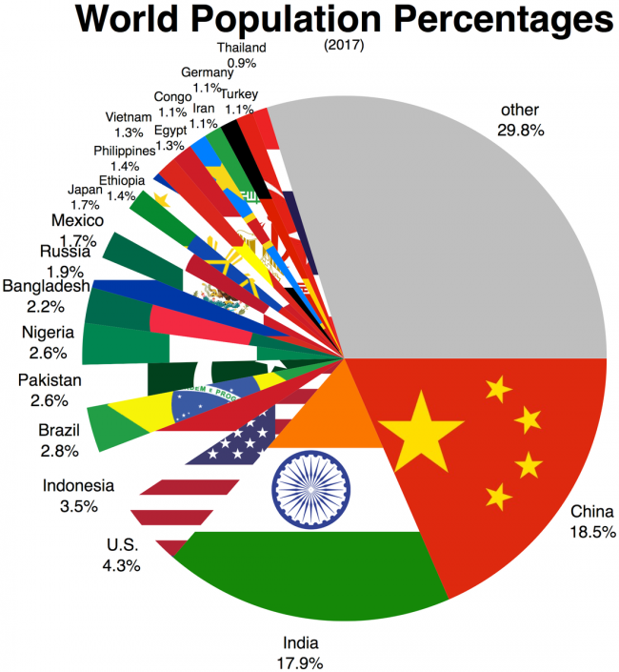

Slide 4
About Dataset
Problem - The increased world population is among the fierce problems the world is facing right now and it will get uncontrolled in the coming future if proper steps for its betterment were not taken immediately. This world has observed the fastest growth during the 20th century. By the end of this year, it will cross 8 billion.
Dependent Variable – Current population , Independent Variable – Area, land area, density, growth rate
Supervised Learning
Methodology This dataset is uploaded with the assumption to use Linear Regression, Machine learning and Predictive analytics skills and answer the following questions.
Which countries have the highest growth rate.
What are the densely populated countries in the world.
Keeping in view all the variables in mind which countries should take serious steps to control their population.

Slide 5

Hypothesis
This 4 variables can predict the population which is Area, land area, density, growth rate.

Slide 6
About this file
About this file
The dataset has 9 columns, description of each column is as follows
Country name: This column includes names of 205 countries of the world.
Current population: current population of the country.
Population 2022: Population of the country in the previous year i.e., 2022
Area: Area of the country in kilometer square (km^2)
Land area: Land of the country km^2.
Density: This column shows the number of people living per square kilometer.
Growth rate: Annual growth rate of the country. Where the +ve sign shows an increase in growth rate while the -ve growth rate shows a decrease in growth rate.
World percentage: the country has how much percentage of the world population.
Rank: this last column shows the rank of the country in the world.

Slide 7
Model Building
Data
Supervised linear regression
Model building
Prediction

Slide 8
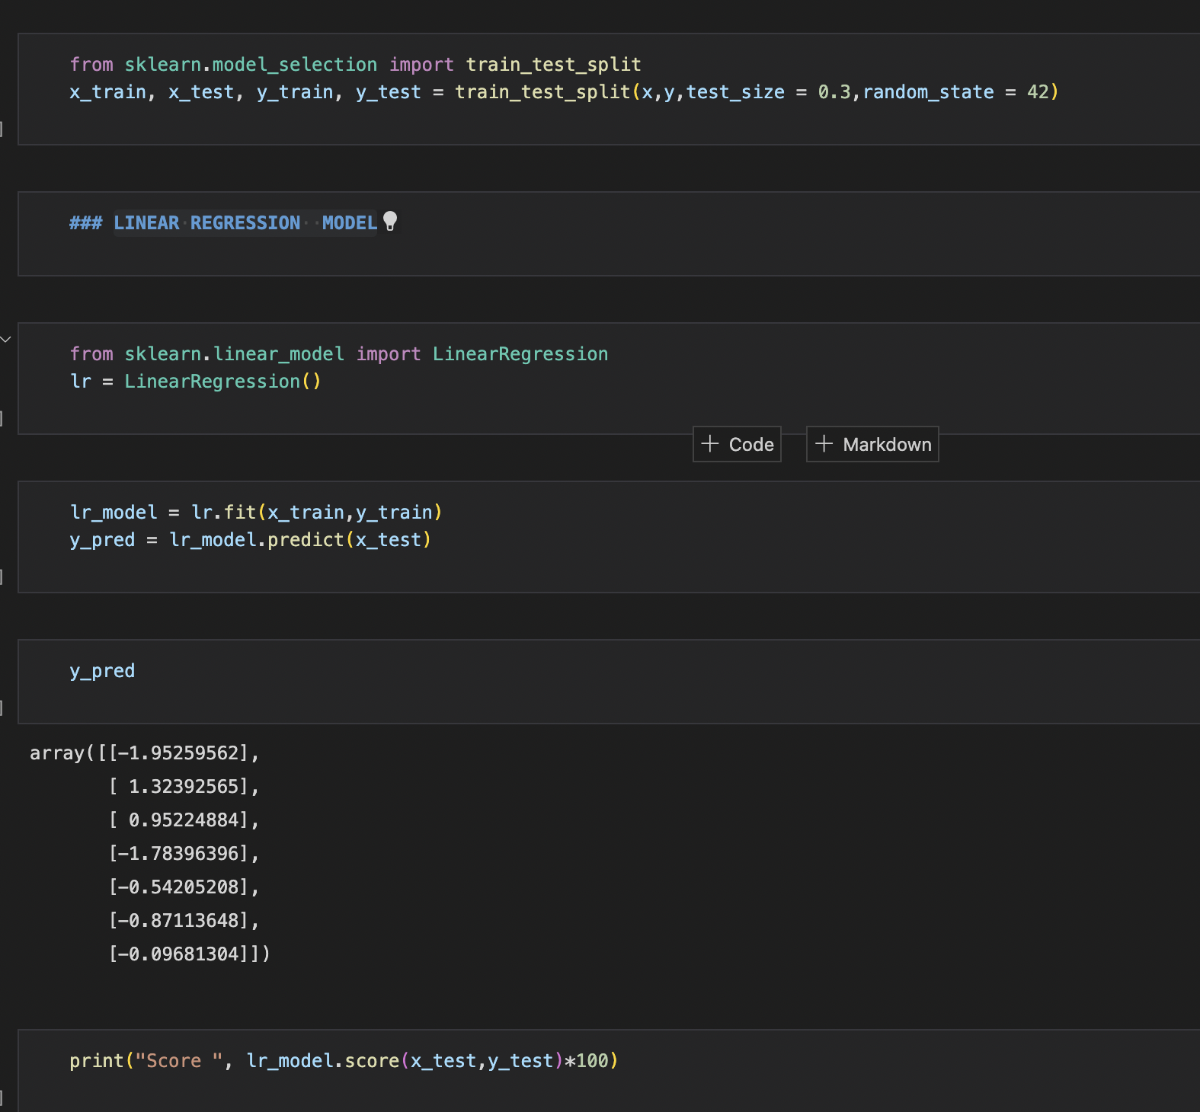
LINEAR REGRESSION MODEL

Slide 9

What are the countries and dependencies with negative growth rates ? Exploratory data analysis (EDA) -
No | Country | Population 2023 | Population 2022 | Area(km²) | Land Area(km²) | Density (/km²) | Growth Rate | World % | Rank
0 | Ukraine | 36181079 | 39701739 | 603.5K | 579.4K | 63 | -7.45 | 0.46 | 41
1 | Lebanon | 5413182 | 5489739 | 10.5K | 10.2K | 523 | -2.47 | 0.07 | 122
2 | Bulgaria | 6723268 | 6781953 | 110.9K | 108.6K | 62 | -1.39 | 0.08 | 110
3 | Lithuania | 2728886 | 2750055 | 65.3K | 62.6K | 43 | -1.15 | 0.03 | 142
4 | Latvia | 1838111 | 1850651 | 64.6K | 62.2K | 29 | -1.1 | 0.02 | 151
5 | Serbia | 7175411 | 7221365 | 88.4K | 87.5K | 82 | -1 | 0.09 | 105
6 | Bosnia And Herzegovina | 3218747 | 3233526 | 51.2K | 51.2K | 63 | -0.7 | 0.04 | 137
7 | Croatia | 4017834 | 4030358 | 56.6K | 56K | 72 | -0.54 | 0.05 | 130
8 | Maldives | 522338 | 523787 | 300 | 300 | 1737 | -0.53 | 0.01 | 174
9 | Japan | 123569707 | 123951692 | 377.9K | 364.5K | 338 | -0.53 | 1.54 | 12
10 | Monaco | 36297 | 36469 | 2 | 2 | 18149 | -0.47 | 0 | 217

Slide 10
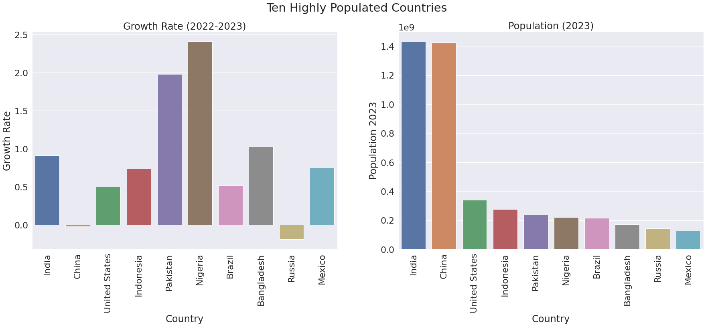
Looking at the growth rates of top 10 highly populated nations: Occupants of Nigeria and Pakistan are increased by 2.41 and 1.98 percentage respectively China and Russia, on the other hand, houses less residents in the Year 2023 as compared to the year 2022

Slide 11
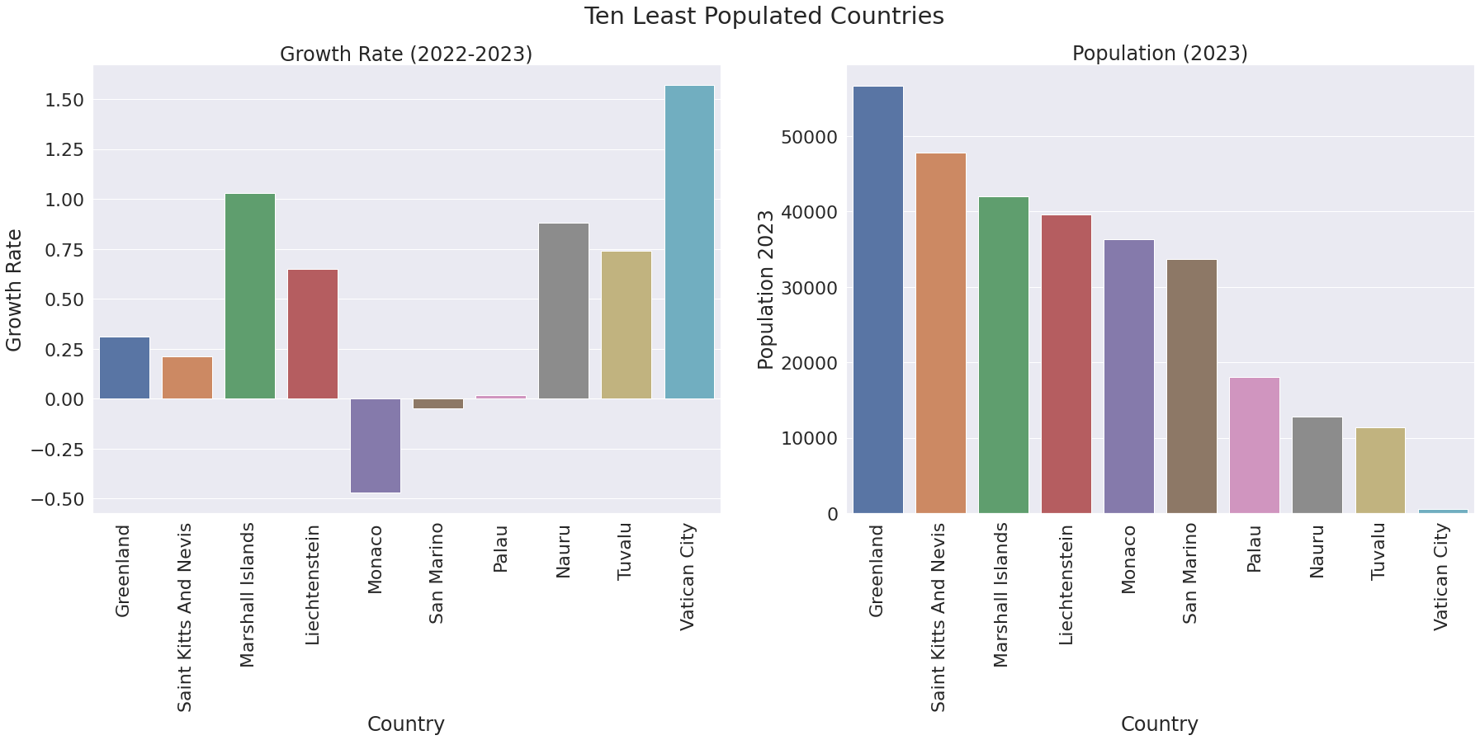
Facts and figures illustrate that : Vatican city, tiniest country in the world, shows a climb in growth rate by 1.57 percentage Monaco's(dependent territory) and San Marino's population size has further shrinked by 0.47 and 0.05 percentage

Slide 12
Top 5 highly dense countries
 |  | Population 2023 | Population 2022 | Area(km²) | Land Area(km²) | Density (/km²) | Growth Rate | World % | Rank
No. | Country
0 | Monaco | 36297 | 36469 | 2 | 2 | 18149 | -0.47 | 0 | 217
1 | Singapore | 5998922 | 5975689 | 710 | 718 | 8377 | 0.65 | 0.08 | 114
2 | Hong Kong | 7488976 | 7488865 | 1.1K | 1.1K | 7135 | 0.04 | 0.09 | 104
3 | Bahrain | 1480242 | 1472233 | 765 | 785 | 1892 | 0.9 | 0.02 | 154
4 | Maldives | 522338 | 523787 | 300 | 300 | 1737 | -0.53 | 0.01 | 174

Slide 13
Top 5 least dense countries
Contry | Population 2023 | Population 2022 | Area(km²) | Land Area(km²) | Density (/km²) | Growth Rate | World % | Rank
Australia | 26329824 | 26177413 | 7.7M | 7.7M | 3 | 1 | 0.33 | 55
Namibia | 2588371 | 2567012 | 825.6K | 823.3K | 3 | 1.45 | 0.03 | 145
Mongolia | 3427406 | 3398366 | 1.6M | 1.6M | 2 | 1.44 | 0.04 | 133
Western Sahara | 581992 | 575986 | 266K | 266K | 2 | 1.96 | 0.01 | 172
Greenland | 56643 | 56466 | 2.2M | 410.4K | 0.14 | 0.31 | 0 | 208

Slide 14
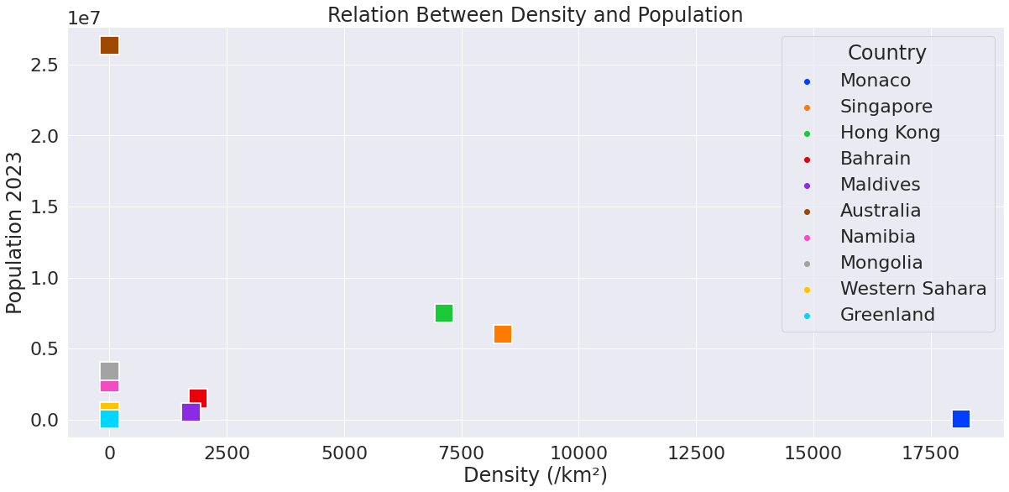
Relation Between Density and Population

Slide 15
Above plot displays the relationship between top five and bottom five countries in terms of population density and population size
It illustrates that:
Population density is defined as average number of individuals in a population per unit of area
If an area is densely populated, that means a larger number of people live in a smaller amount of space
Monaco, a dependency, is highly densed and packed with mere population of 36469 residents
Greenland contains a massive land area to hold its small size population of 56643

Slide 16
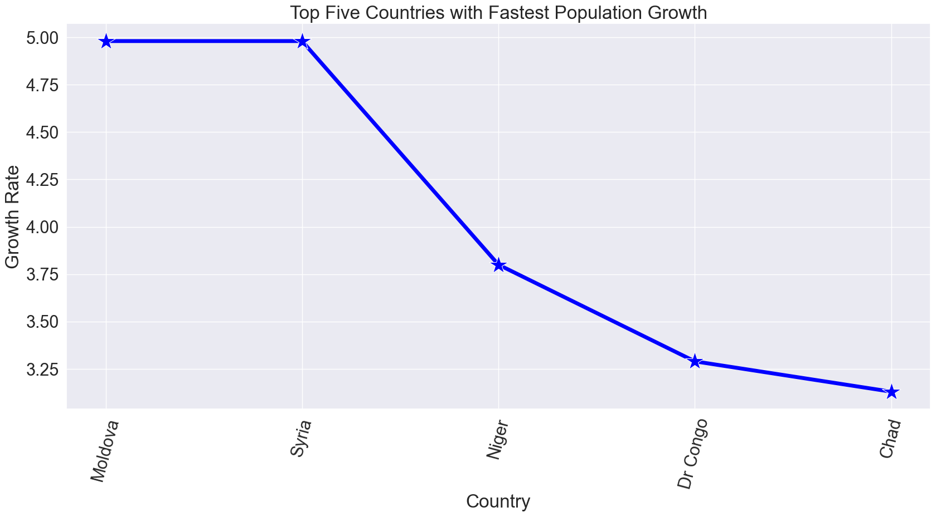
top 5 fastest growing countries in terms of population size

Slide 17
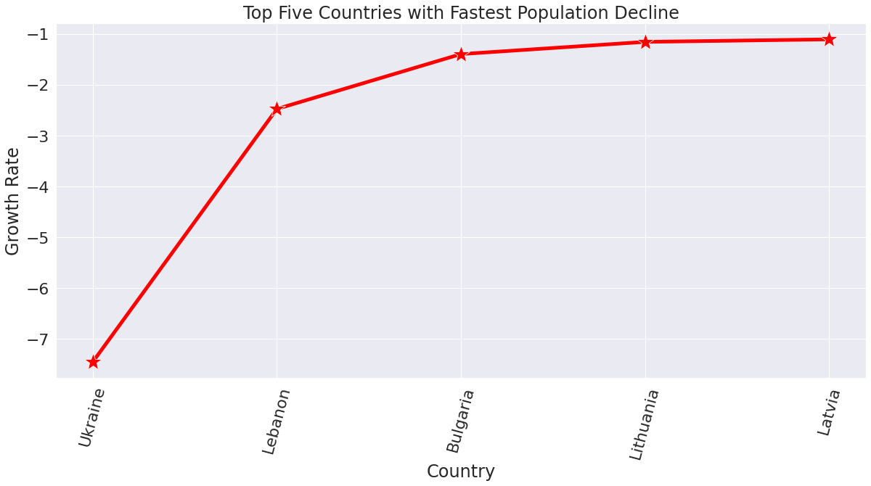
Below analysis clearly depicts that: There are total 32 countries with negative growth rate Population of Ukraine has decreased tremendously by 7.45 percentage followed by Lebanon

Slide 18
What are the countries with 100 million population ?
 |  | Population 2023 | Population 2022 | Area(km²) | Land Area(km²) | Density (/km²) | Growth Rate | World % | Rank
No. | Country
0 | India | 1429834379 | 1417173173 | 3.3M | 3M | 481 | 0.91 | 17.85 | 1
1 | China | 1425820141 | 1425887337 | 9.7M | 9.4M | 151 | -0.02 | 17.81 | 2
2 | United States | 339231549 | 338289857 | 9.4M | 9.1M | 37 | 0.5 | 4.25 | 3
3 | Indonesia | 276576867 | 275501339 | 1.9M | 1.9M | 148 | 0.74 | 3.47 | 4
4 | Pakistan | 238517163 | 235824862 | 881.9K | 770.9K | 312 | 1.98 | 3 | 5
5 | Nigeria | 221592544 | 218541212 | 923.8K | 910.8K | 246 | 2.41 | 2.8 | 6
6 | Brazil | 215904975 | 215313498 | 8.5M | 8.4M | 26 | 0.52 | 2.7 | 7
7 | Bangladesh | 172220907 | 171186372 | 147.6K | 130.2K | 1329 | 1.03 | 2.16 | 8
8 | Russia | 144652401 | 144713314 | 17.1M | 16.4M | 9 | -0.19 | 1.8 | 9
9 | Mexico | 128061868 | 127504125 | 2M | 1.9M | 66 | 0.75 | 1.6 | 10
10 | Ethiopia | 125199807 | 123379924 | 1.1M | 1.1M | 112 | 2.55 | 1.58 | 11
11 | Japan | 123569707 | 123951692 | 377.9K | 364.5K | 338 | -0.53 | 1.54 | 12
12 | Philippines | 116598689 | 115559009 | 342.4K | 298.2K | 394 | 1.54 | 1.47 | 13
13 | Egypt | 111991086 | 110990103 | 1M | 1M | 113 | 1.56 | 1.41 | 14
14 | Dr Congo | 100880253 | 99010212 | 2.3M | 2.3M | 45 | 3.29 | 1.28 | 15

Slide 19
Summary of Analysis Model Accuracy – Score 93.56430720672756
Dataset at hand, compares global population figures of 2022 and 2023(January) of 205 countries and dependencies
Following facts are concluded with the help of statistical and graphical analysis:
US Census Bureau's world population clock estimated that the global population as of January 2023 has reached 8 billion
China and India are the most heavily populous countries in the World
About 36 % of the World population resides just in India and China
India has surpassed China as the world's most populous nation
Surprisingly population of China declined by -0.02 percentage as of Jan 2023 compared to the previous year
Vatican City, smallest country in the world in terms of both population and total area, accommodates barely 518 residents
China and India, are far from the most densely populated countries. They are simply too large to have the highest population density
Monaco is the world's most densely populated place
China's and Russia's population size has decreased remarkably and marked below zero,inspite on the list of top 10 populated countries
Vatican City, Tuvalu and Nauru, smallest countries in the world with least global population have remarkable growth rate of above 0.75
Moldova and Syria are the top two countries with the elevated growth rate of 4.98 percentage
Population of Ukraine has decreased tremendously by 7.45 percentage followed by Lebanon
According to United Nations: Fertility rates, Increasing longevity, Conflicts and war between nations, International migration are influential factors behind population growth and decline

Slide 20
References :
Dataset:
https://www.kaggle.com/datasets/dinarkhan/worldpopulation2023
World Population Reports:
https://worldpopulationreview.com/
https://www.un.org/en/global-issues/population
Seaborn Tutorial:
https://elitedatascience.com/python-seaborn-tutorial
https://www.statology.org/seaborn-line-thickness/
Seaborn Subplots Tutorial:
https://datagy.io/seaborn-titles/
https://www.tutorialspoint.com/how-to-rotate-tick-labels-in-a-subplot-in-matplotlib
https://stackoverflow.com/questions/31186019/rotate-tick-labels-in-subplot-pyplot-matplotlib-gridspec

Slide 21

This Photo by Unknown Author is licensed under CC BY-SA-NC

